Slide 1
neoliberalism and psychotherapy

Slide 2
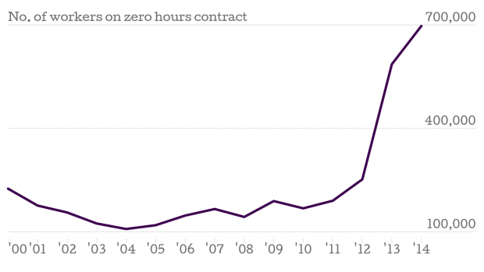
UK

Slide 3
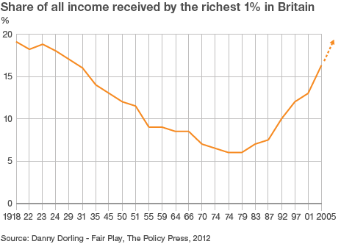

Slide 4
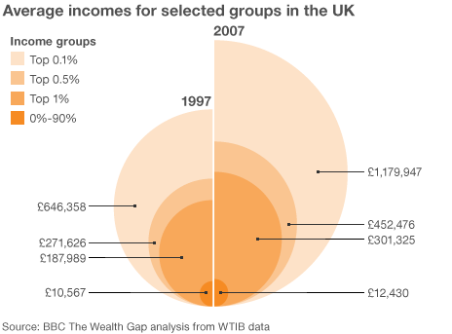

Slide 5
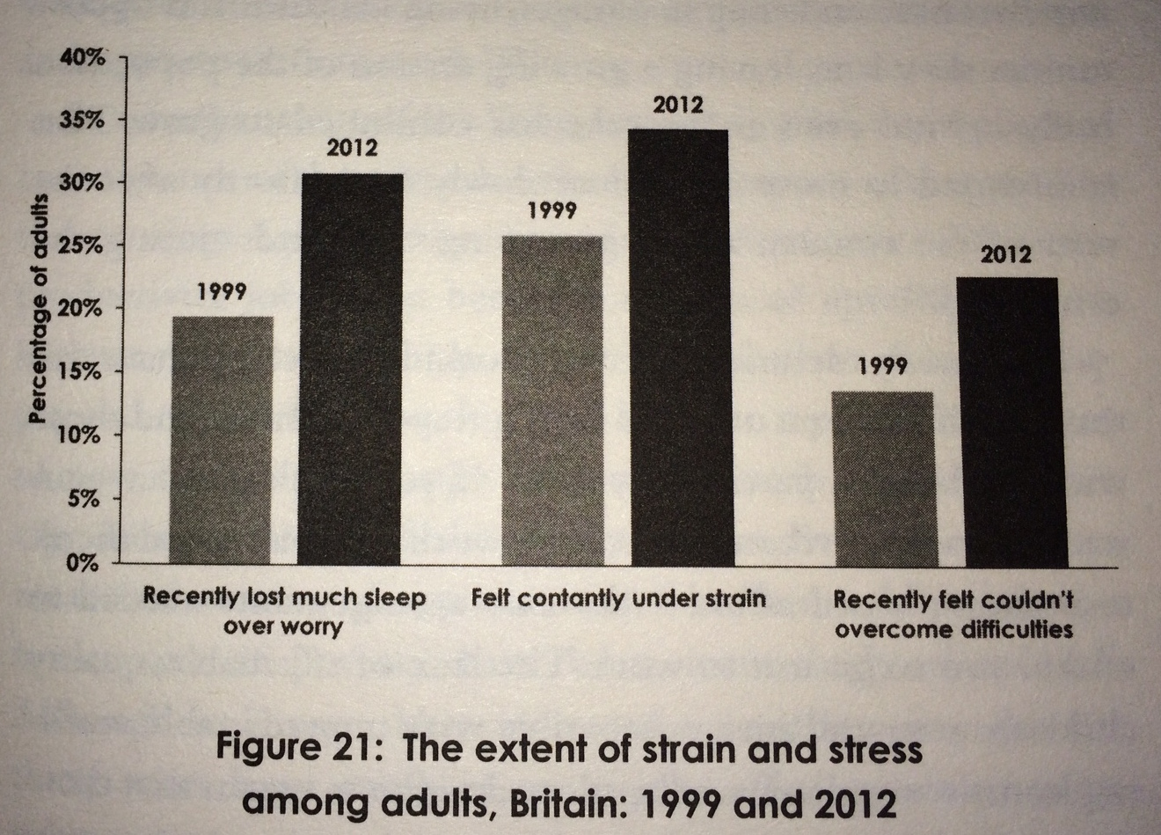

Slide 6
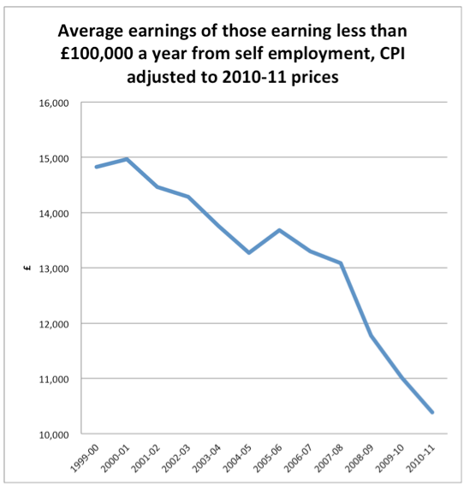

Slide 7
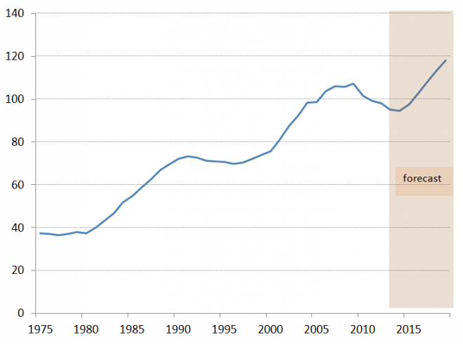
UK household debt as a share of GDP, per cent

Slide 8
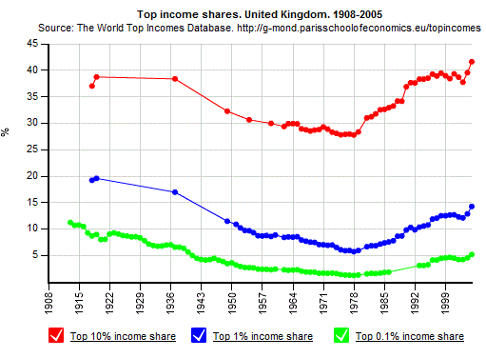

Slide 9
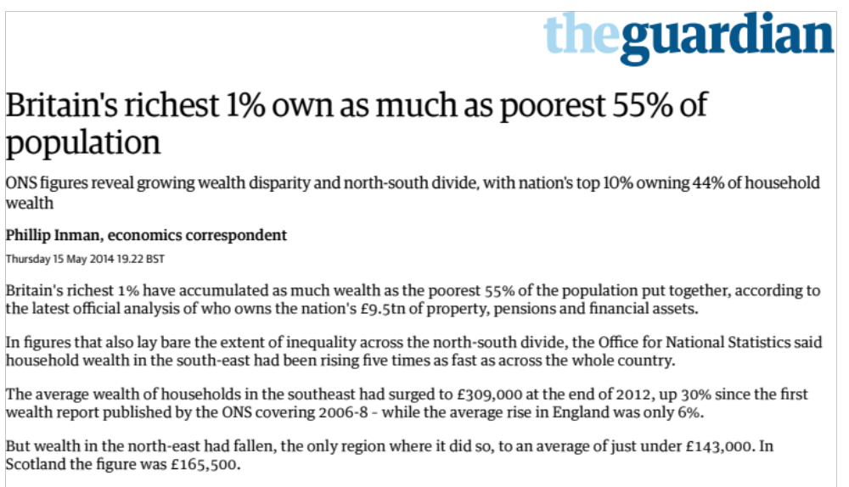

Slide 10
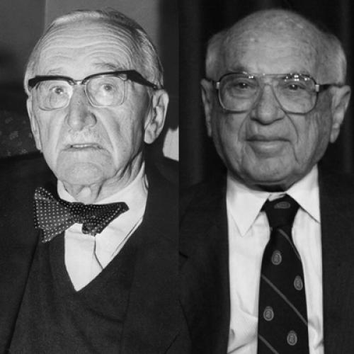
Friedrich Hayek and Milton Friedman

Slide 11
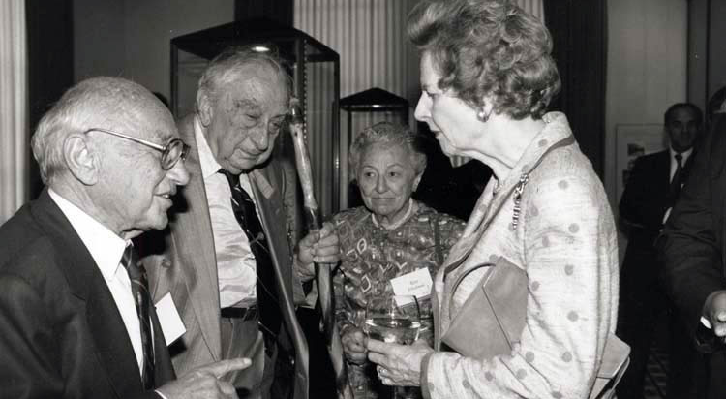

Slide 12
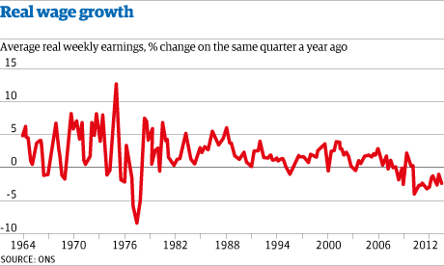

Slide 13
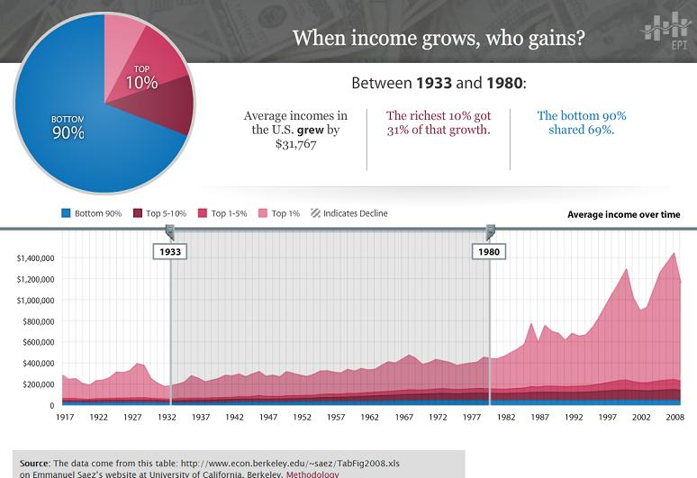

Slide 14
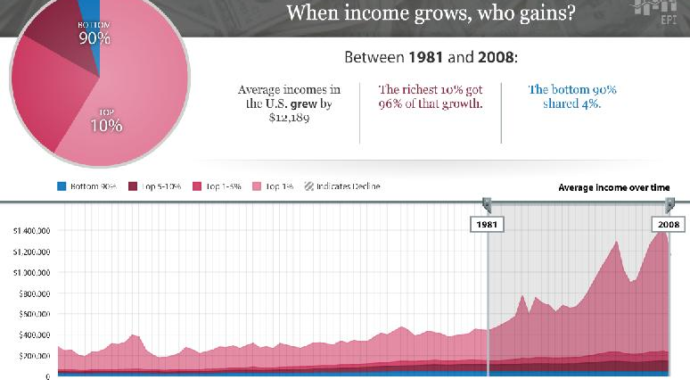

Slide 15
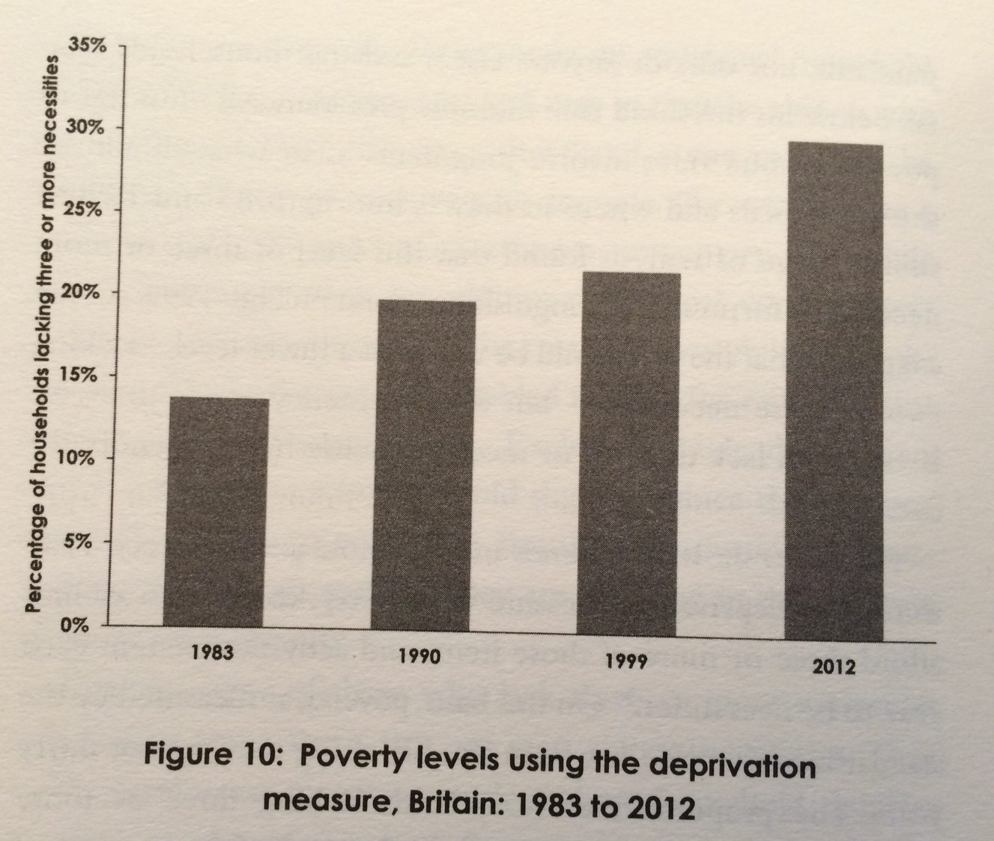
Breadline Britain Lansley & Mack 2015

Slide 16
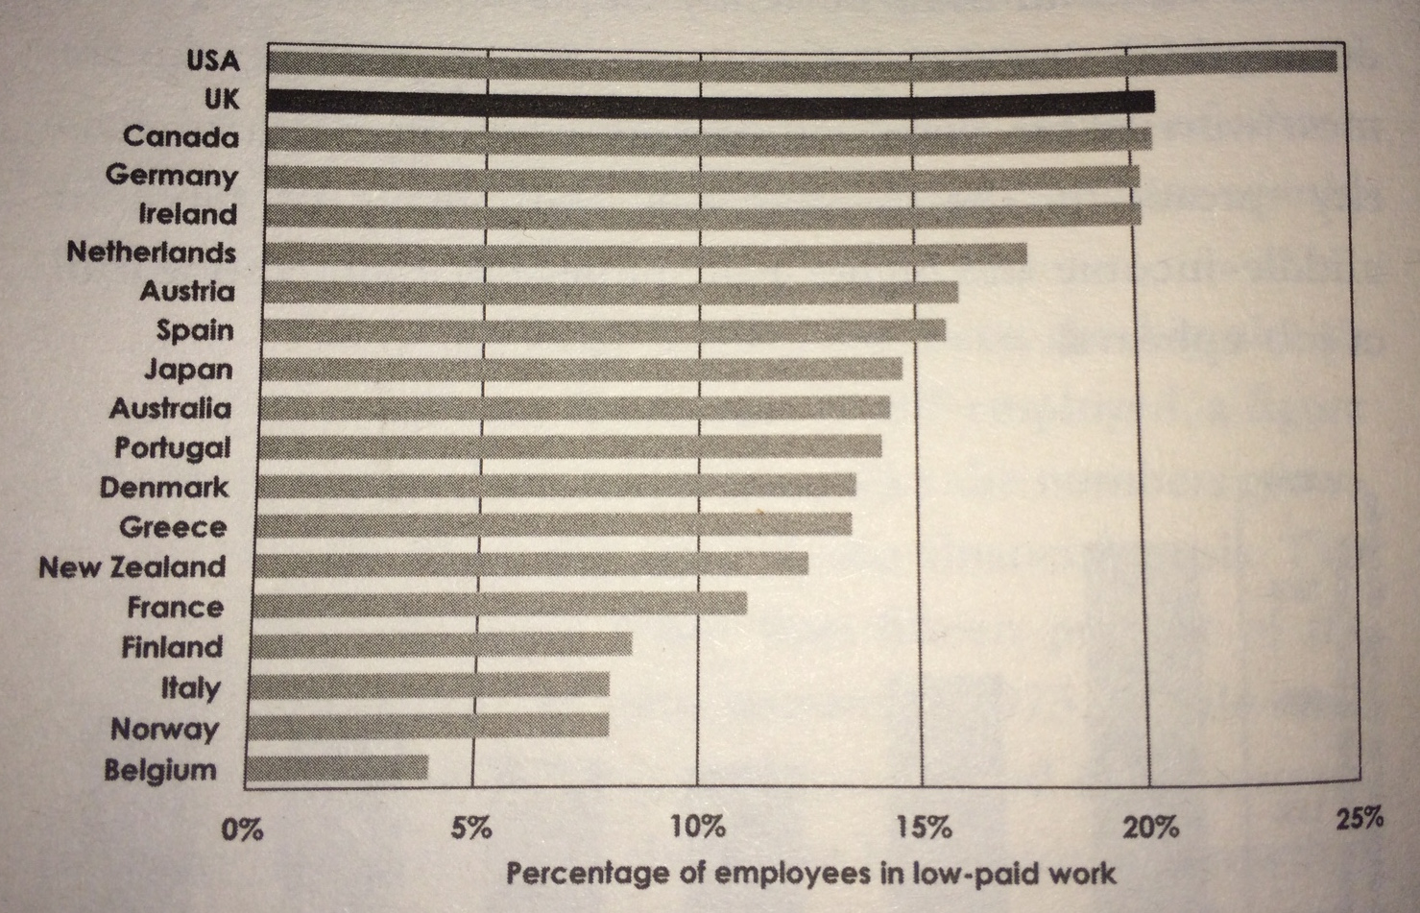
Breadline Britain

Slide 17
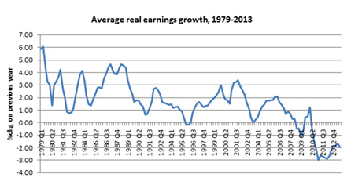

Slide 18
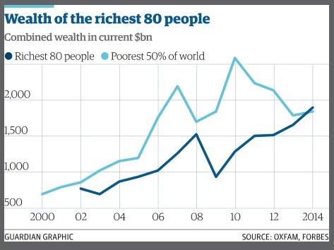

Slide 19
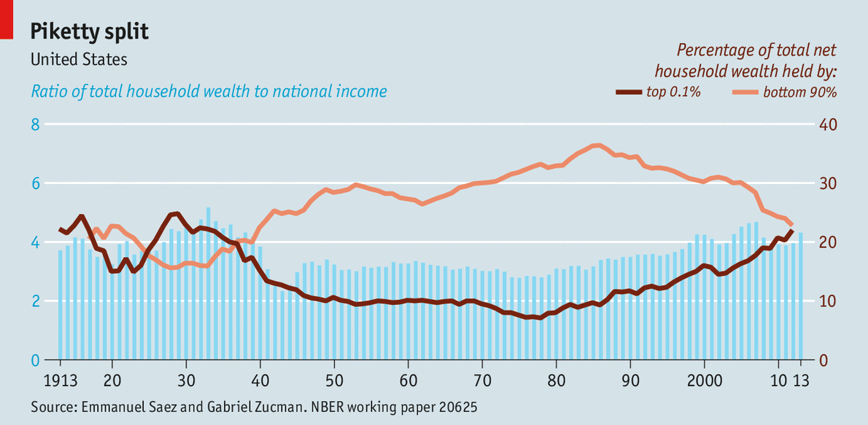

Slide 20
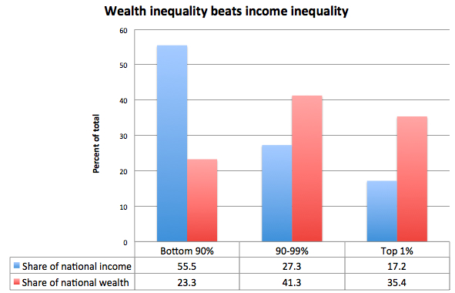

Slide 22
UK

Slide 23
UK Household debt

Slide 24
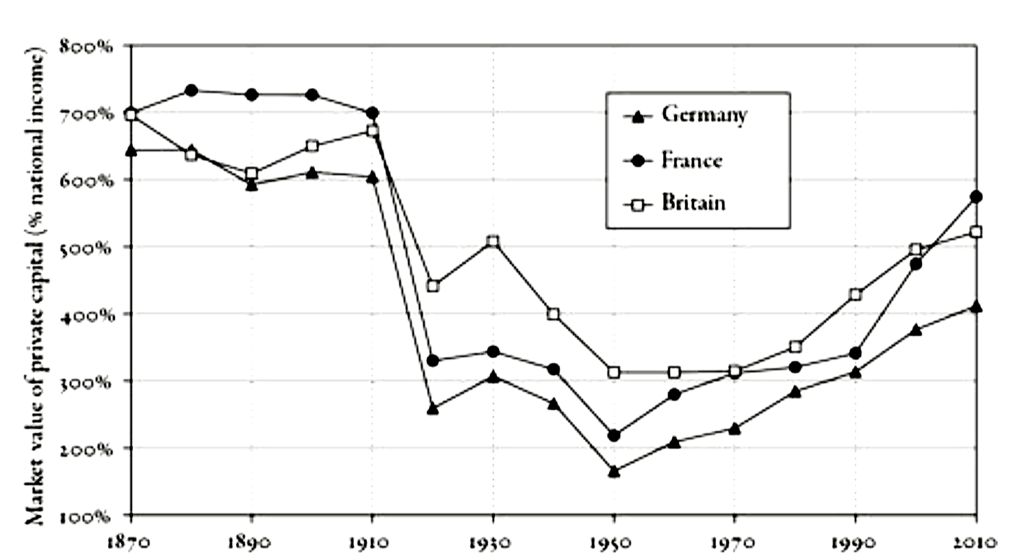
Piketty
Notes:
Piketty

Slide 25
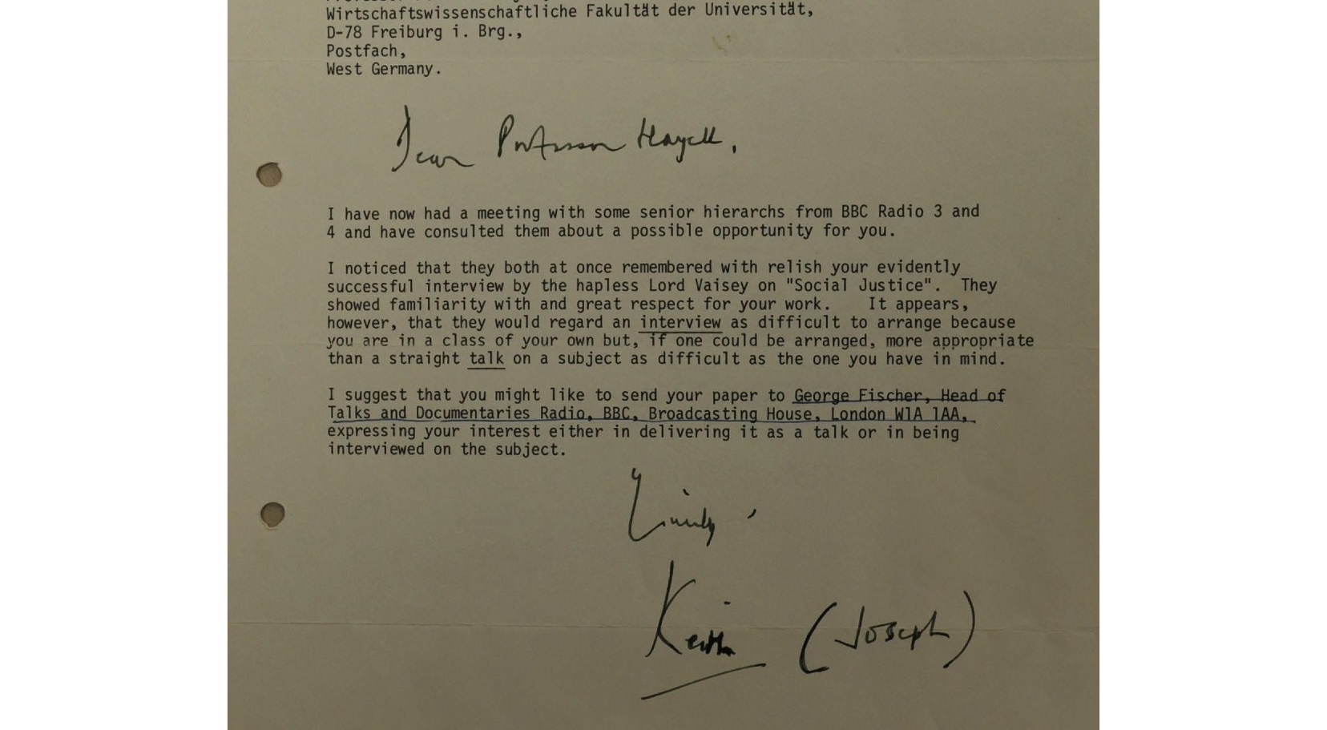

Slide 26


Slide 27

What are the differences between traditional psychology
and community psychology?

Slide 28

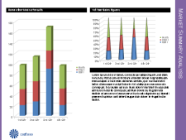
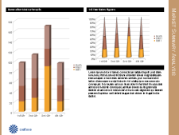
Using the Pitchbook Template
About the Template
Pitchbooks are structured presentations with tightly packed text and graphics. They are usually intended for print rather than projection.
Some typical characteristics of a pitchbook presentation include:
Smaller text sizes and more dense content layouts to enable communication of large amounts of information
Simple graphical elements which print quickly and accurately
High degree of consistency between slides and among sections of slides
To start creating slides using this template, click the Home tab, and then click New Slide.
Customizing the Logo
Branding with Color
To customize this template for your business, you may want to replace our generic logo with your own.
To do this for all of your slides, switch to Slide Master View.
On the View menu, point to Masters, and then click Slide Master.
From here, you can add your own logo. You can also customize or add additional layouts to create even more types of slides with this template.
To style your slides with your company’s brand colors while maintaining the template’s simple layout, change the color scheme or create your own:
On the Themes tab, under Theme Options, click Colors, and then select a color scheme.
My Logo

Slide 29
Sample Slides

Slide 30
Annual Report
Market Risk
Fiscal Year 2005 Annual Report
Quarter Ended | 1st Qtr. | 2nd Qtr. | 3rd Qtr. | 4th Qtr. | Total
Fiscal year 2003
Revenue | $7,746 | $8,541 | $7,835 | $8,065 | $32,187
Gross profit | 6,402 | 6,404 | 6,561 | 6,761 | 26,128
Net income | 2,041 | 1,865 | 2,142 | 1,483 | 7,531
Basic earnings per share | 0.19 | 0.17 | 0.2 | 0.14 | 0.7
Diluted earnings per share | 0.19 | 0.17 | 0.2 | 0.14 | 0.69
Fiscal year 2004
Revenue | $8,215 | $10,153 | $9,175 | $9,292 | $36,835
Gross profit | 6,735 | 7,809 | 7,764 | 7,811 | 30,119
Net income | 2,614 | 1,549 | 1,315 | 2,690 | 8,168
Basic earnings per share | 0.24 | 0.14 | 0.12 | 0.25 | 0.76
Diluted earnings per share | 0.24 | 0.14 | 0.12 | 0.25 | 0.75
Fiscal year 2005
Revenue | $9,189 | $10,818 | $9,620 | $10,161 | $39,788
Gross profit | 7,720 | 8,896 | 8,221 | 8,751 | 33,588
Net income | 2,528 | 3,463 | 2,563 | 3,700 | 12,254
Basic earnings per share | 0.23 | 0.32 | 0.24 | 0.34 | 1.13
Diluted earnings per share | 0.23 | 0.32 | 0.23 | 0.34 | 1.12
Includes charges totaling $750 million (pre-tax) related to the Fabrikam settlement and $1.15 billion in impairments of investments. Includes stock-based compensation charges totaling $2.2 billion for the employee stock option transfer program. Includes charges totaling $756 million (pre-tax) related to Contoso subsidiaries and other matters.
Fiscal Year 2004

Slide 33
Market Summary Analysis
1st Year Sales Figures
Market Distribution
Financial Summary
Our perennial 3rd Quarter boost was larger than expected contributing to an exceptionally strong year. Distribution of sales across the geographic markets looks fairly steady.
Our new product line, released this year, is early in its adoption phase. We expect to see substantial revenue contribution from these products over the next two years.

Slide 34
Business Summary
Market Share by Division
Business Process Model
Product Division | 2002 | 2003 | 2004 | 2005
Electronics | 10.3 % | 12.1% | 13.2% | 17.0%
Consumer Goods | 1.3% | 2.3% | 2.2% | 2.7%
Services | 12.0% | 11.0% | 8.9% | 9.2%
Widget Sales | 78.0% | 82.3% | 82.5% | 84.0%
Installations | 5.3% | 7.9% | 12.2% | 15.1%
Percentages based on domestic comparison to competitors in directly related industries. Percentages based on standing at the end of each fiscal year. Values provided by a third party agency.
Operating
Supporting
Optimizing
Changing
Organizational Structure
Summary
Contoso
Product Development
Design
Quality Assurance
Human Resources
Headquarters
Subsidiaries
Manufacturing
Finance
This has been a pivotal year for the company in growth, but also development of our infrastructure and business processes. We’ll continue to focus on our internal systems over the next year.
Specific growth areas include Electronics where Contoso has seen as 6.7% increase in market share over the last three years. An area to monitor closely is the Services division where market share has dropped slightly.

